Slide 1
Introduction
Background information
Cell / nuclear structure
Collective cell migration
Significance
Tissue engineering
Wound healing
Figure(s)

Slide 2
Materials & Methods
Scratch Wound Assay
Procedure – description and cartoon
Imaging / staining techniques
Automated cell tracking
GSK 126
Highly selective EZH2 methyltransferase inhibitor
Trichostatin-A (TSA)
Class I and II HDAC inhibitor

Slide 3
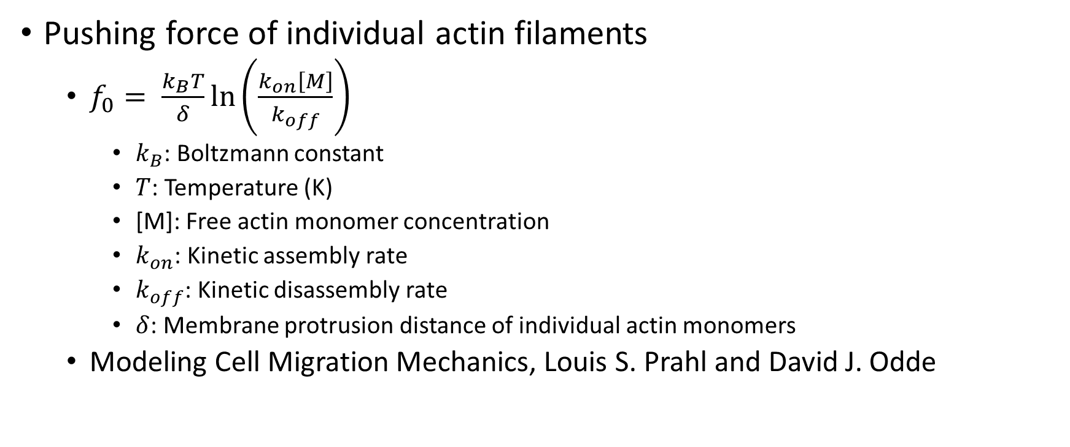
Biophysical Model – Force Based Approach
Pushing force of individual actin filaments
$f_{0}= \frac{k_{B}T}{δ}ln⁡\left(\frac{k_{on}\left[M\right]}{k_{off}}\right)$
$k_{B}$: Boltzmann constant
$T$: Temperature (K)
[M]: Free actin monomer concentration
$k_{on}$: Kinetic assembly rate
$k_{off}$: Kinetic disassembly rate
$δ$: Membrane protrusion distance of individual actin monomers
Modeling Cell Migration Mechanics, Louis S. Prahl and David J. Odde

Slide 4
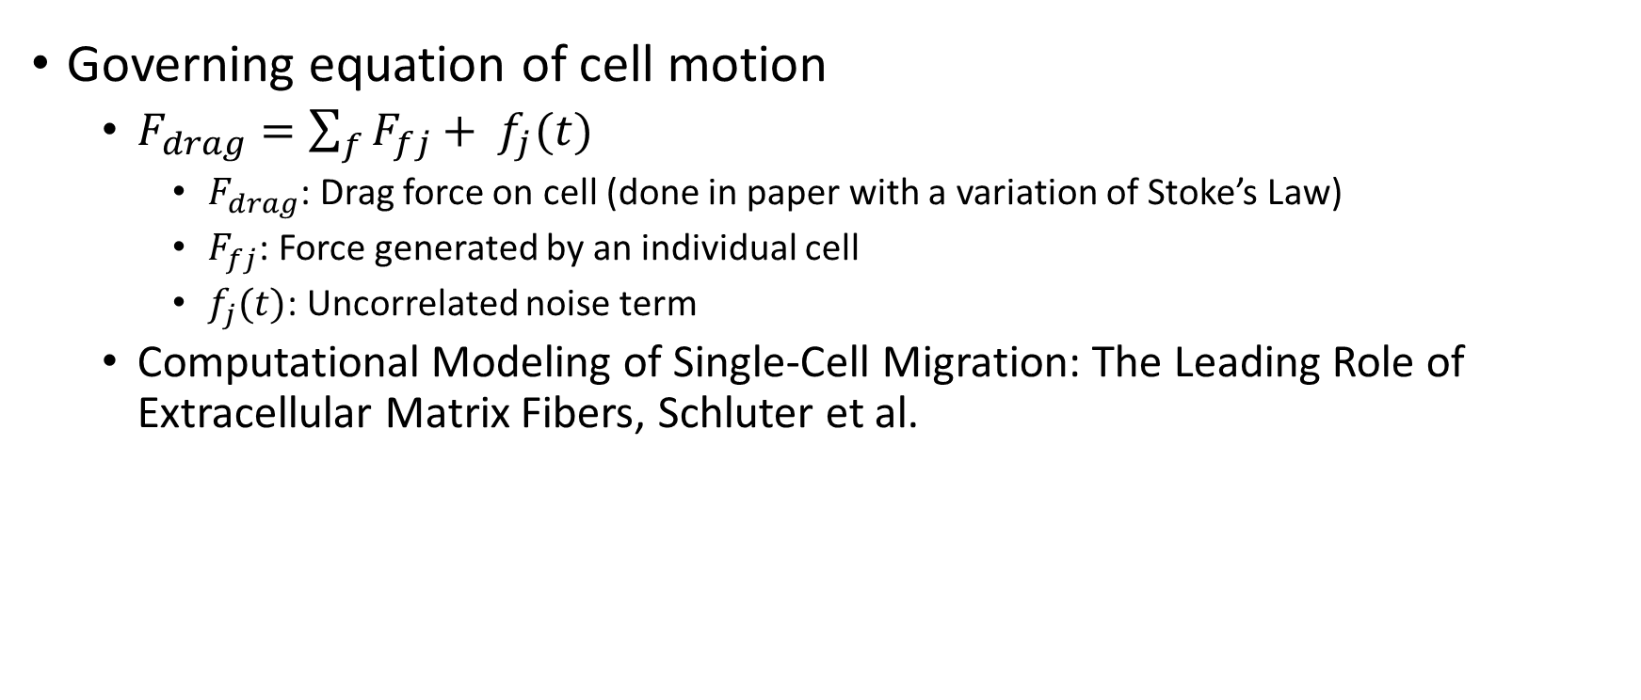
Biophysical Model – Force Based Approach
Governing equation of cell motion
$F_{drag}=\sum_{f}{F_{fj}+ f_{j}(t)}$
$F_{drag}$: Drag force on cell (done in paper with a variation of Stoke’s Law)
$F_{fj}$: Force generated by an individual cell
$f_{j}(t)$: Uncorrelated noise term
Computational Modeling of Single-Cell Migration: The Leading Role of Extracellular Matrix Fibers, Schluter et al.

Slide 5
Results
Migration violin plots – control
Fixed time point migration images
% wound closure data
Automated cell tracking data for treatments
Possibly QR code for migration video(s)

Slide 6
Discussion
Epigenetic modification with TSA and GSK
Inhibit HDAC and EZH2 methyltransferase respectfully
Affected a mechanism crucial to collective migration

Slide 7
Future Research
Study with MSCs as opposed to fibroblasts
Investigating impacts of cell crowding and substrate mechanics
Investigate the effects found in a 3D space

Slide 8
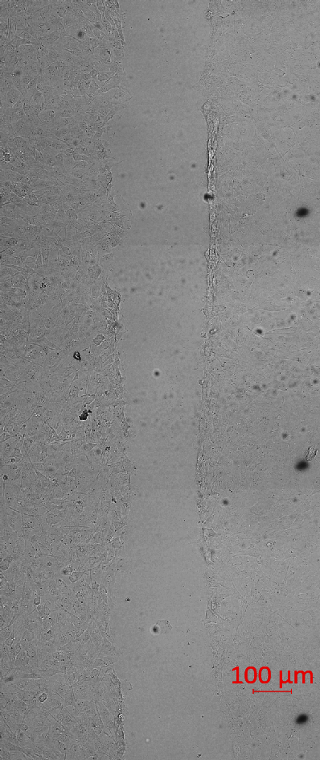
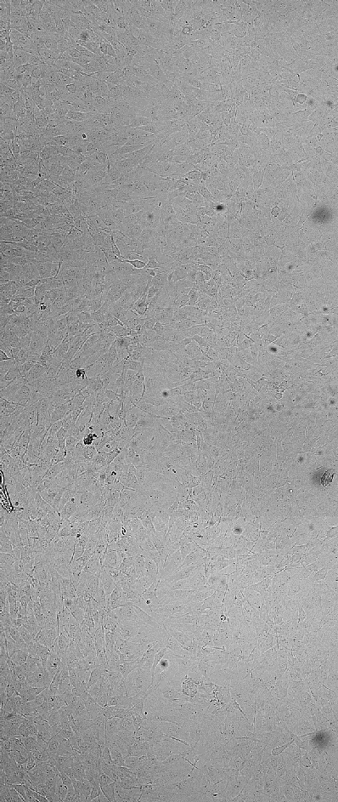
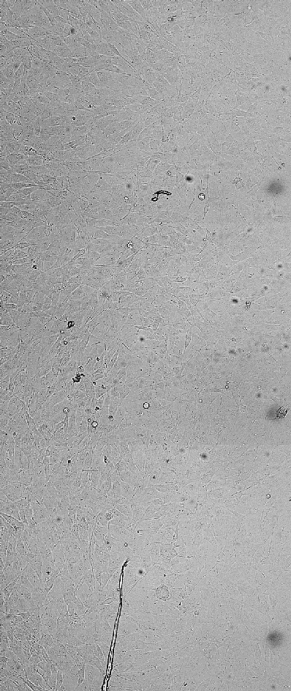
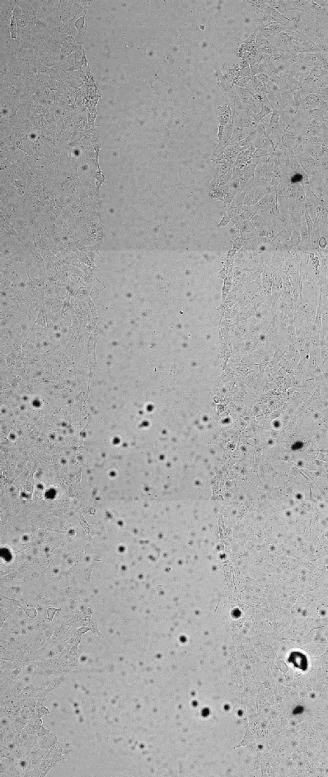
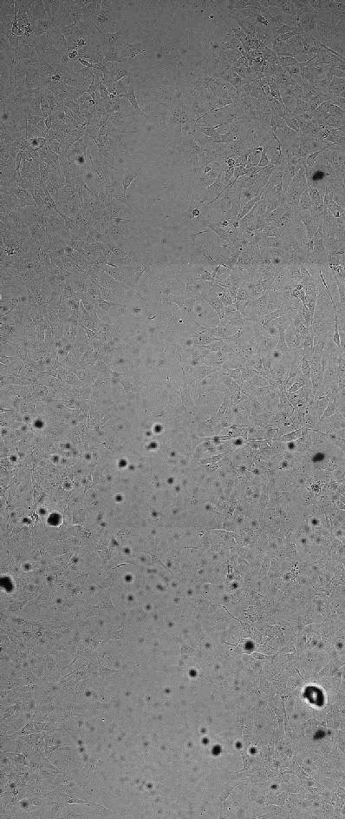
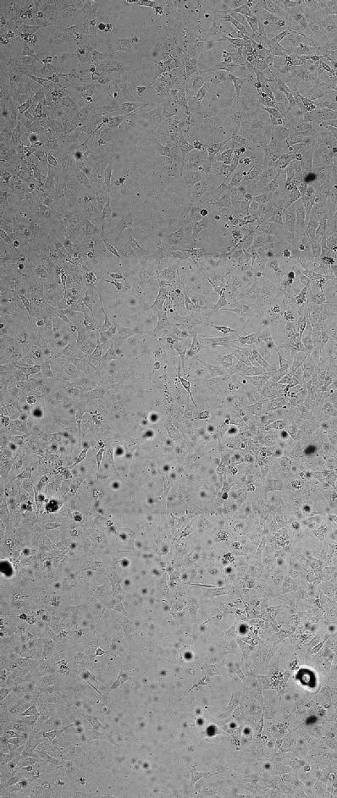
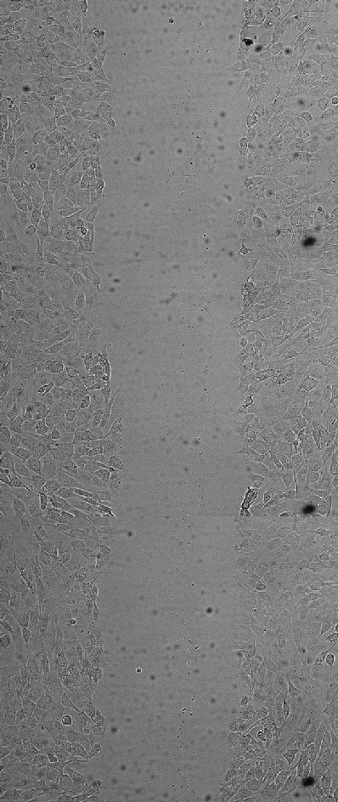
Control Group
100 ng/mL Trichostatin A
0 hours after scratch
11 hours after scratch
24 hours after scratch
0 hours after scratch
11 hours after scratch
24 hours after scratch
20μM GSK126
Control 25.5 hrs
GSK 25.5 hrs
TSA 25.5 hrs

Slide 9
Control Group
Control Group
Control Group
20μM GSK126
20μM GSK126
20μM GSK126
100 ng/mL Trichostatin A
100 ng/mL Trichostatin A
Brightfield 25.5 hours post scratch
Stained images 25.5 hours post scratch

Slide 10
Control Group
20μM GSK126
100 ng/mL Trichostatin A
Brightfield 2 hours post scratch
DAPI 2 hours post scratch
DAPI 5.5 hours post scratch
DAPI 8.5 hours post scratch

Slide 11
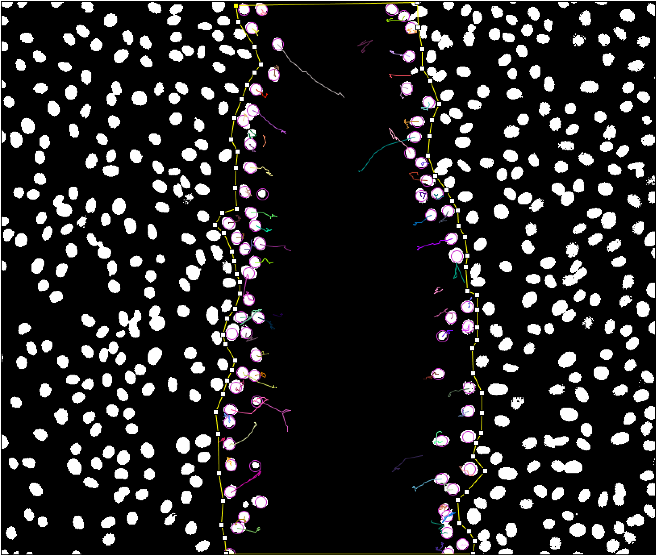
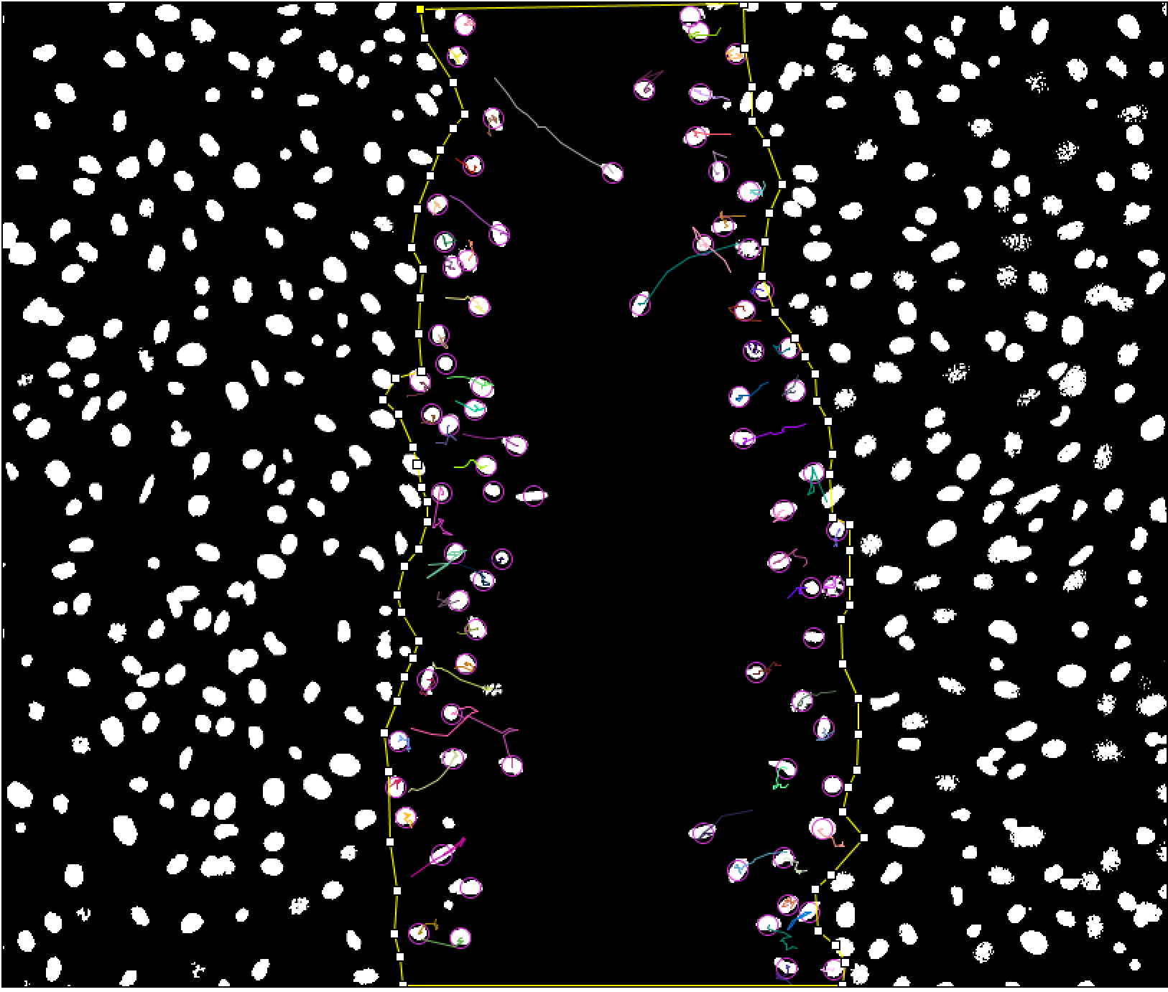
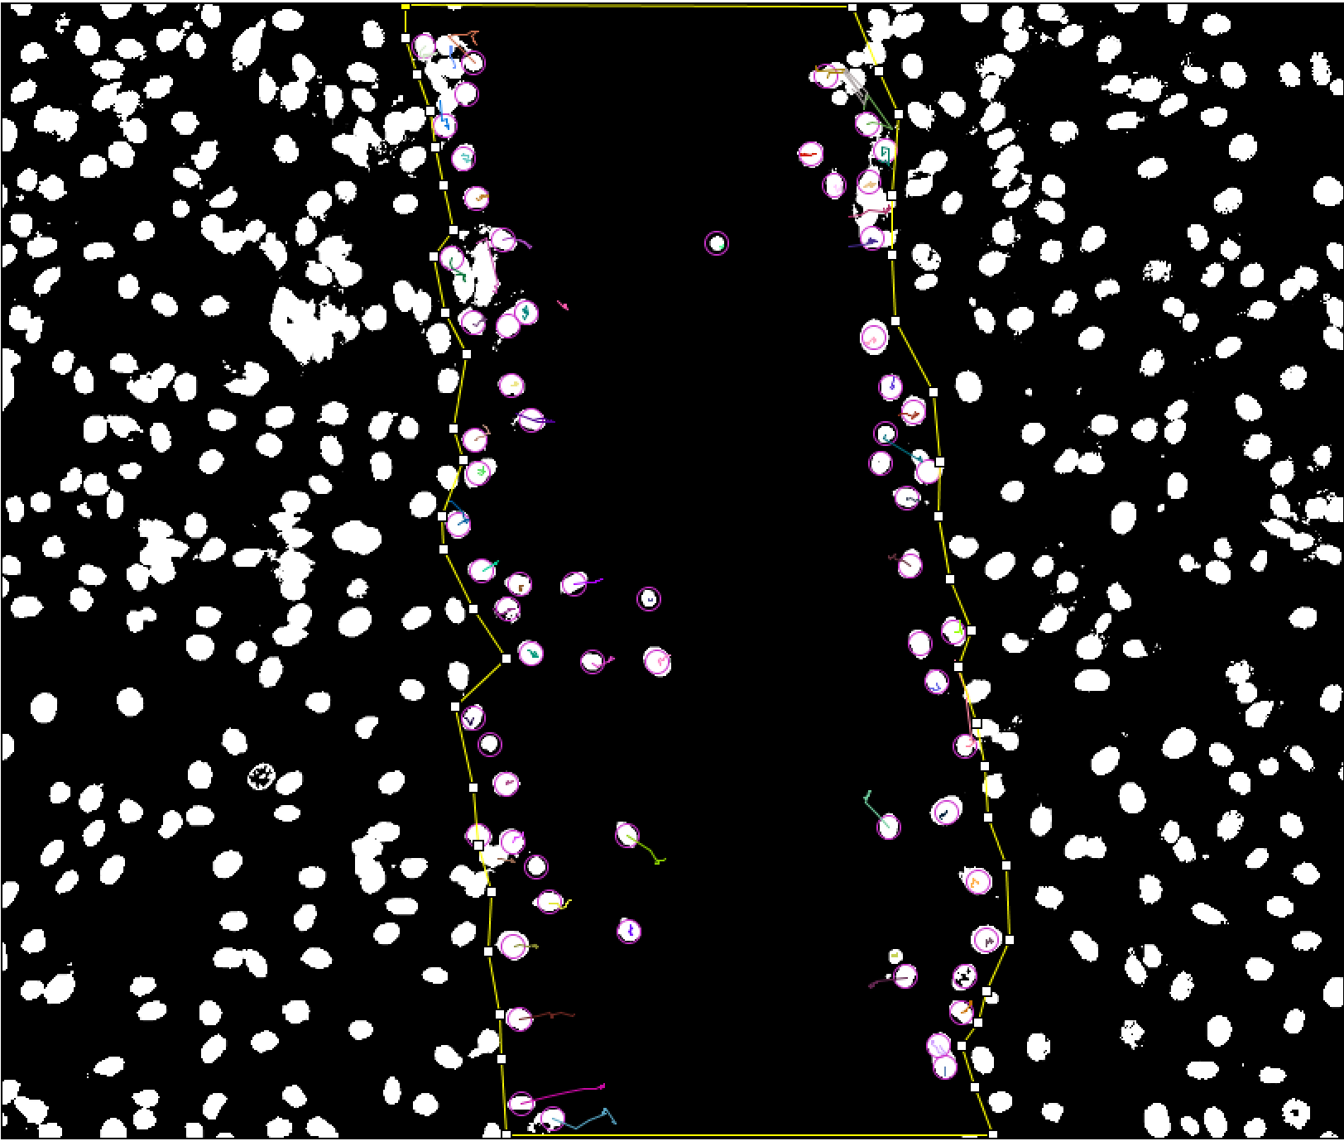
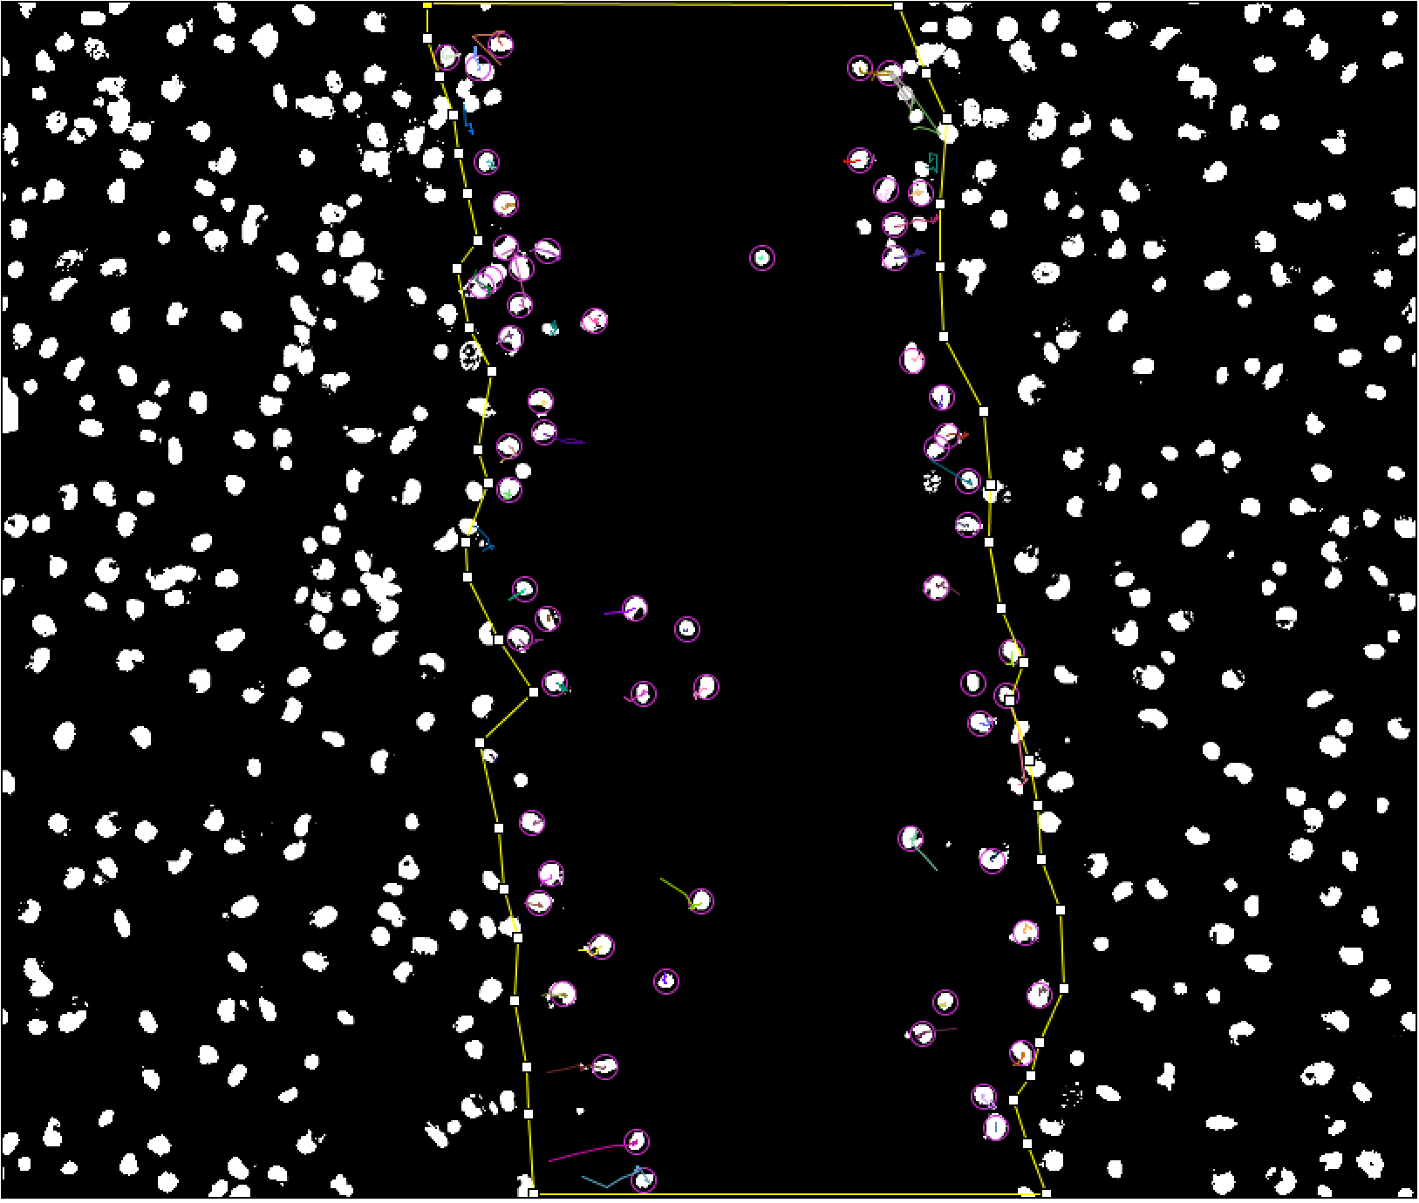
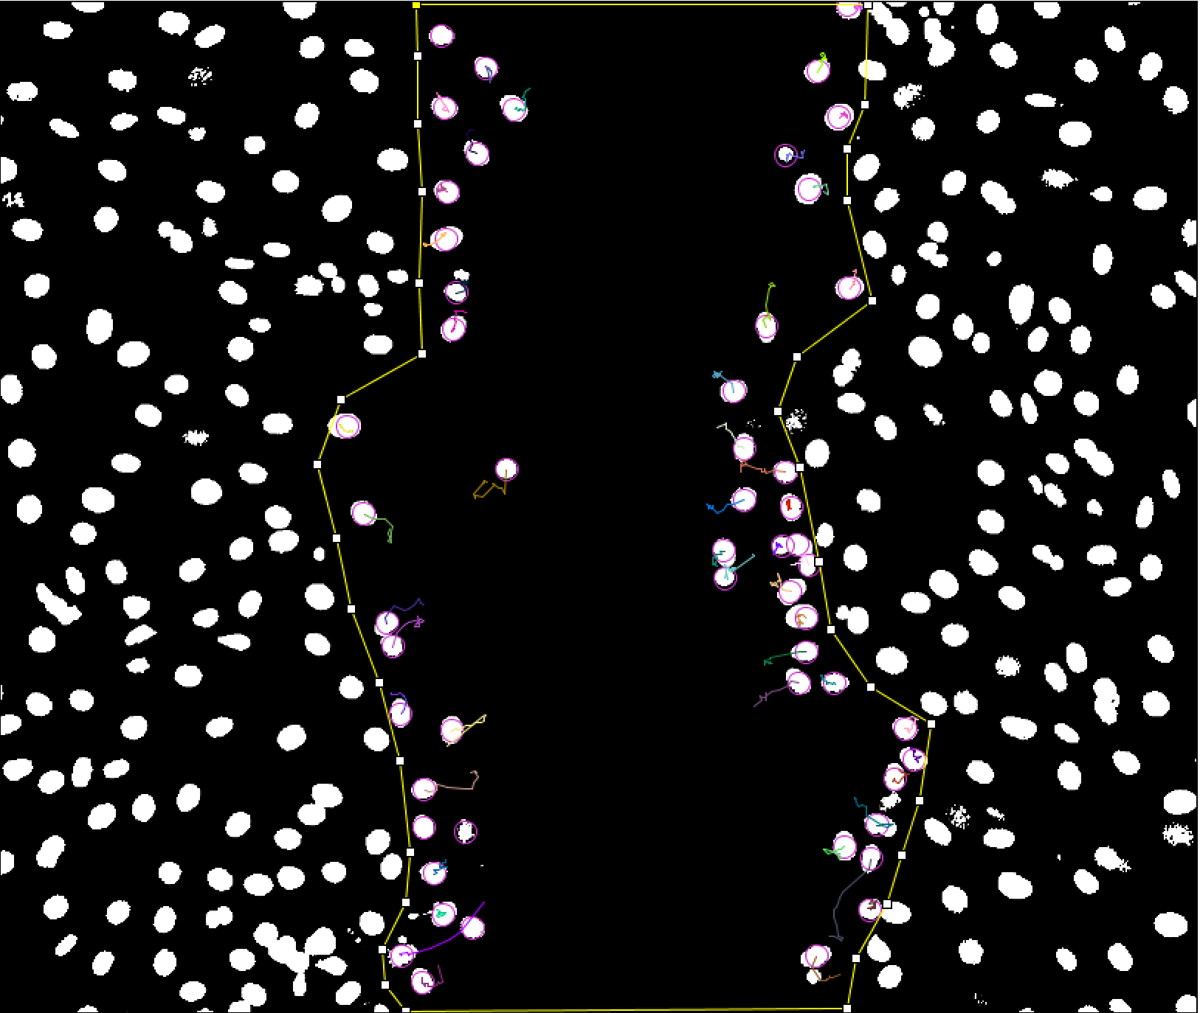
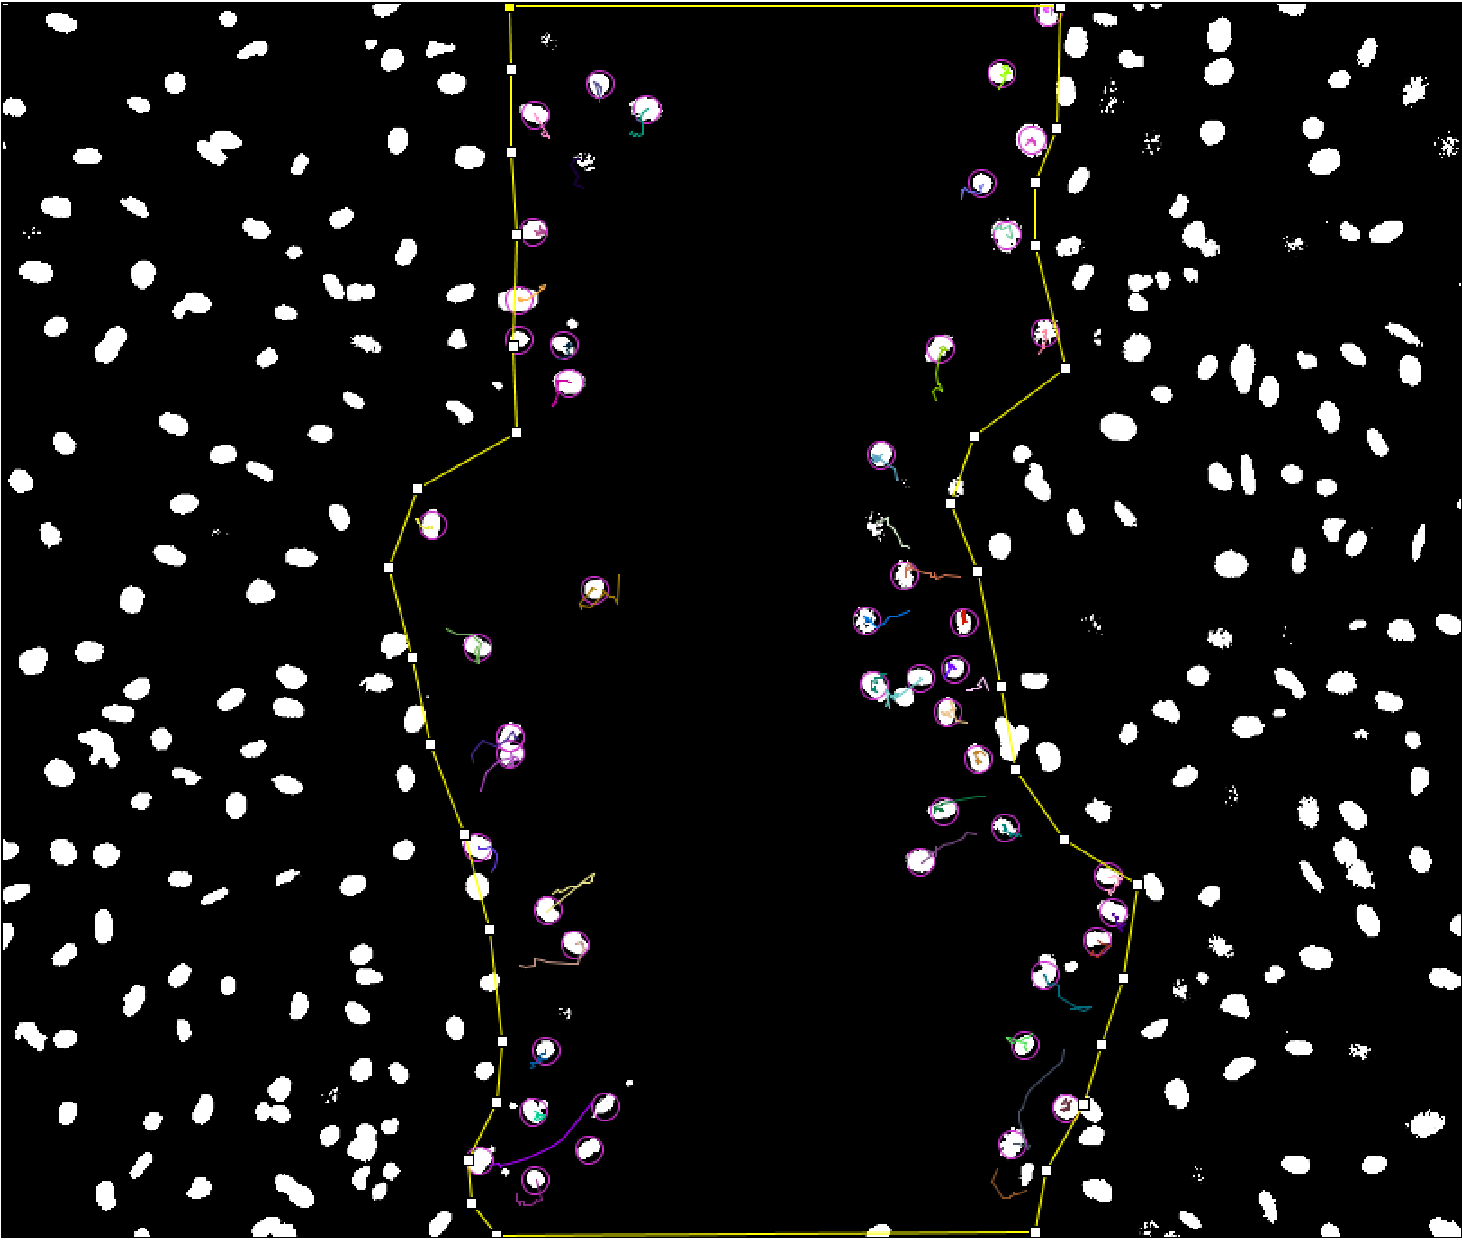
Control Group
20μM GSK126
100 ng/mL Trichostatin A
2 hours post scratch
2 hours post scratch
8.5 hours post scratch

Slide 12
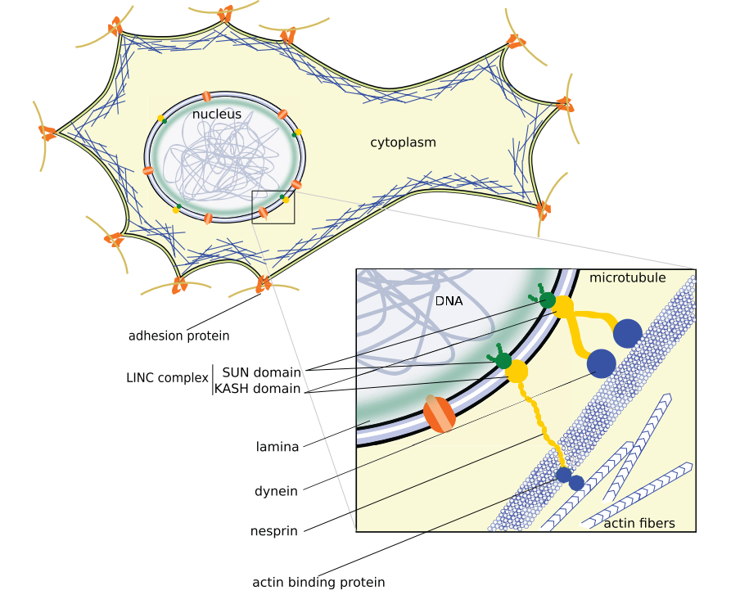
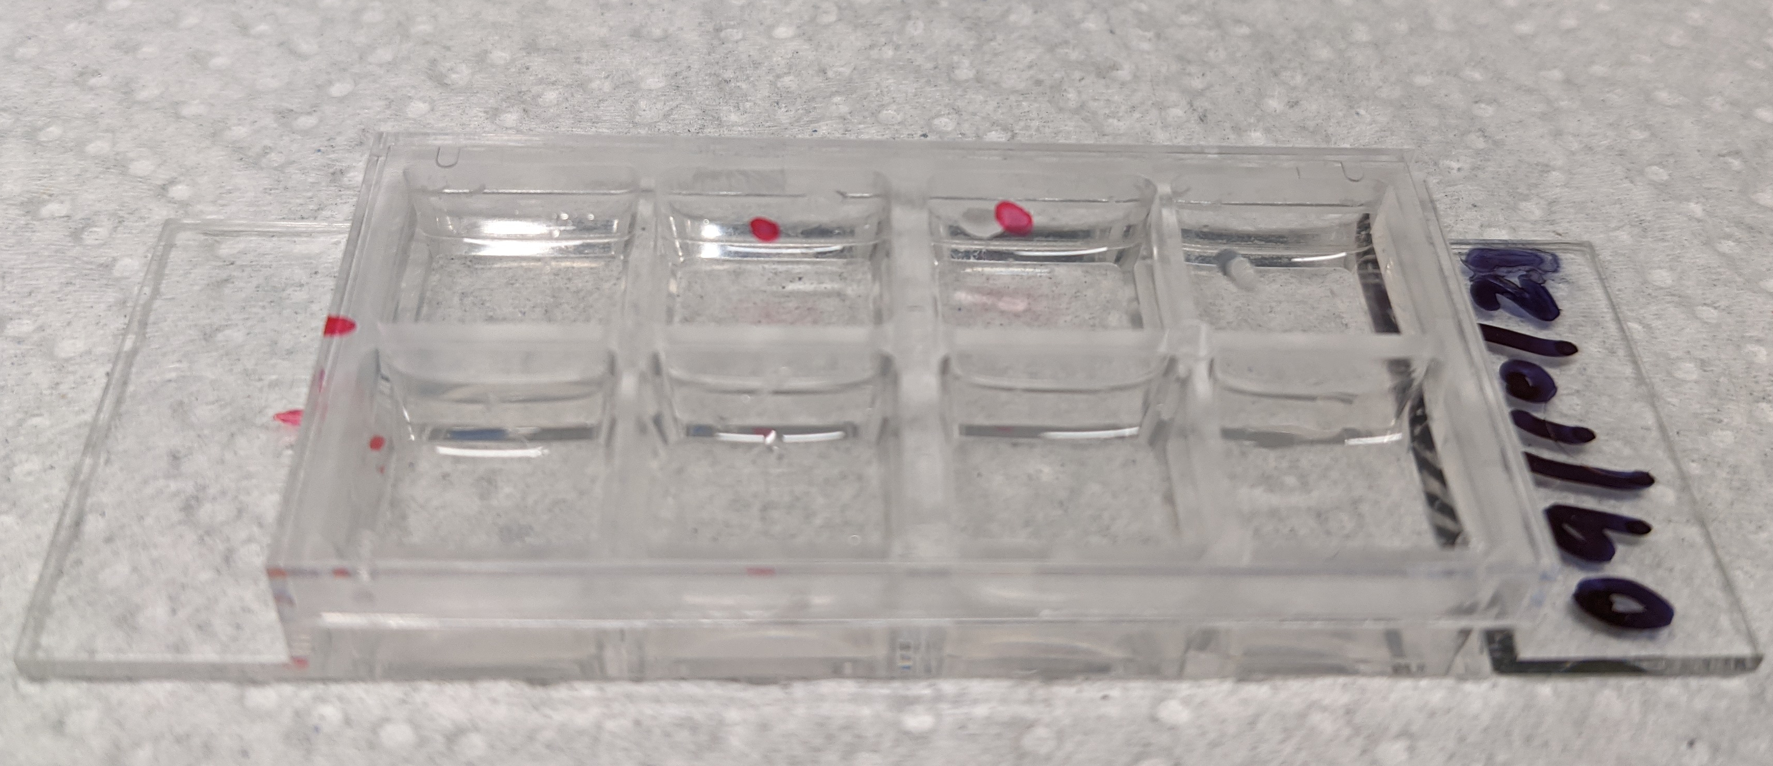
LINC Complex & Well Plate
A. Fruleux and R. J. Hawkins, “Physical role for the nucleus in cell migration,” J. Phys. Condens. Matter, vol. 28, no. 36, p. 363002, Jul. 2016, doi: 10.1088/0953-8984/28/36/363002.

Slide 13
Stained Images

Slide 14
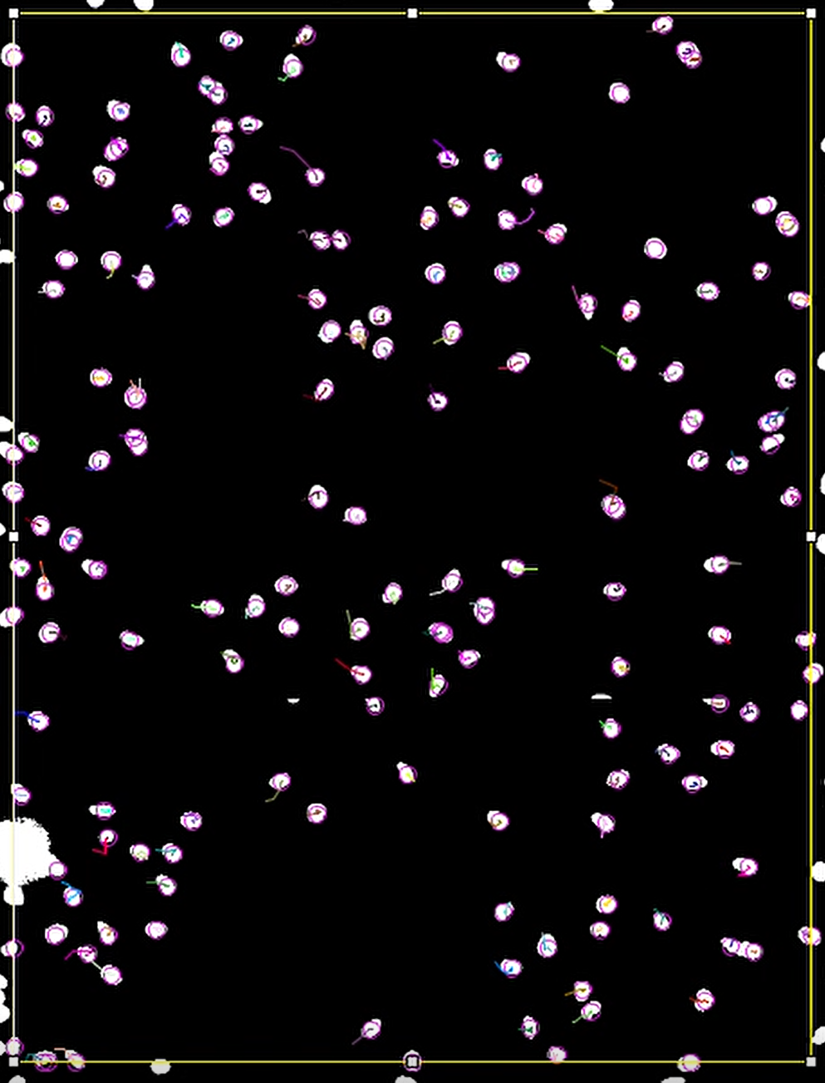
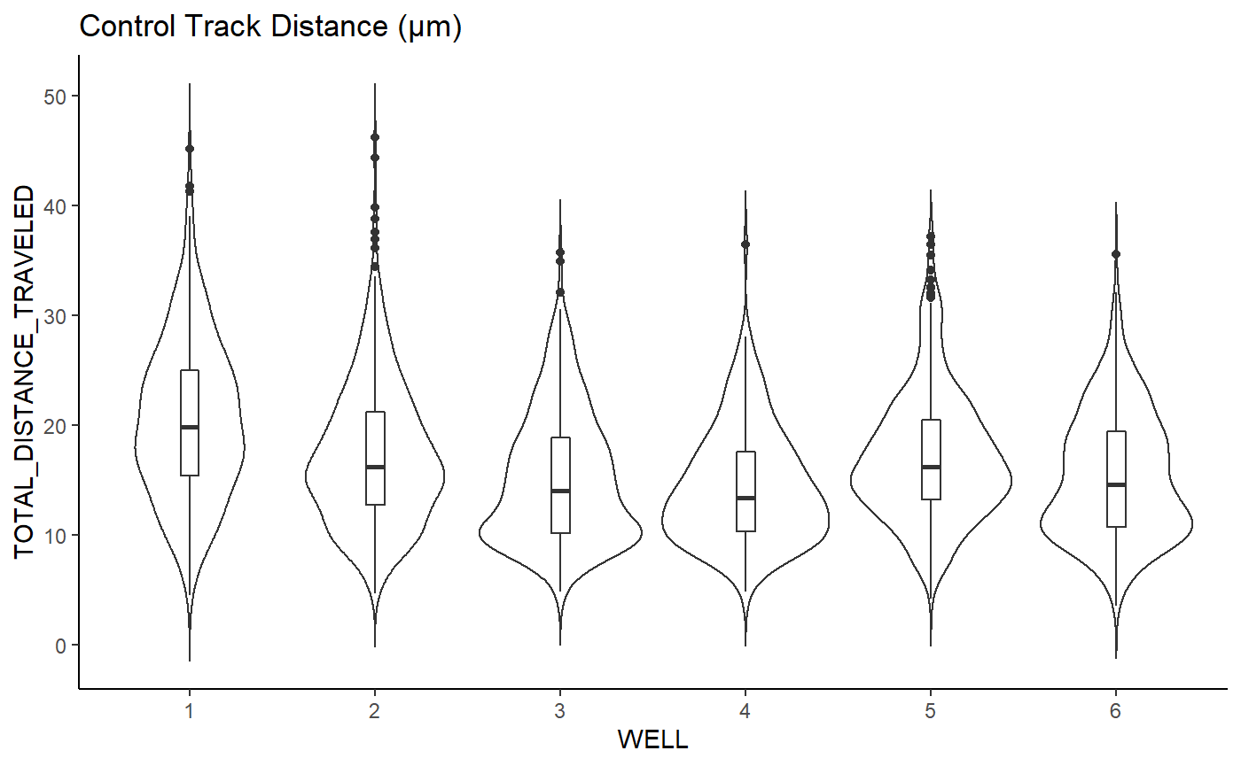
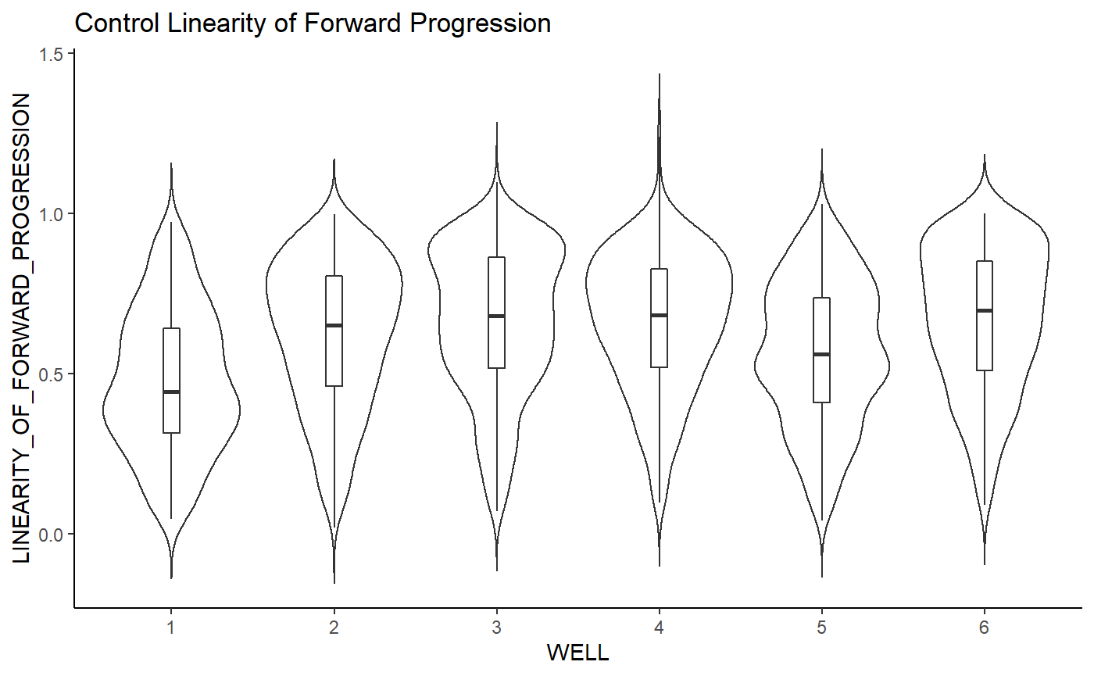
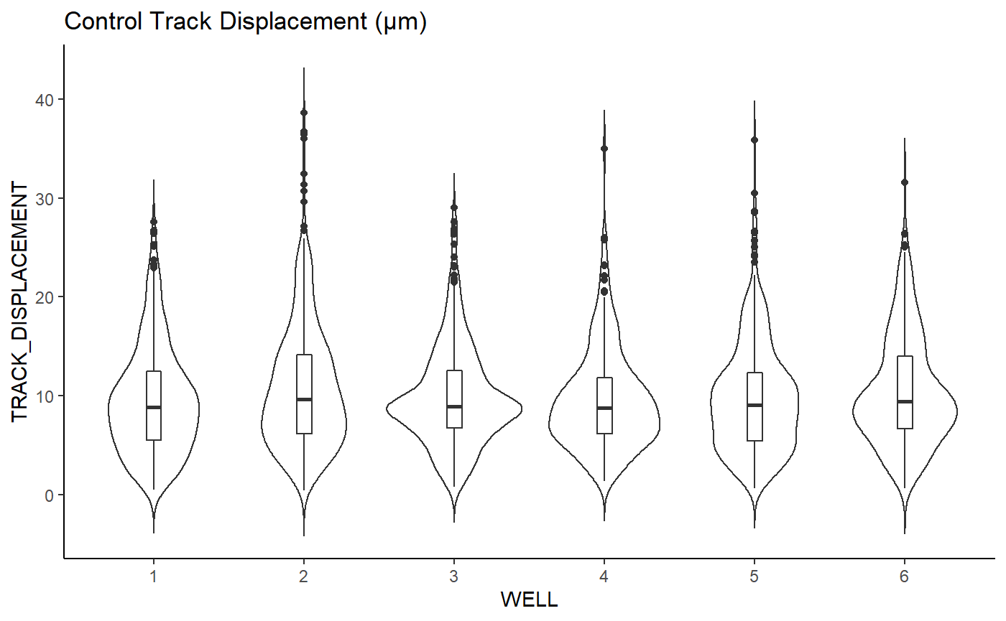
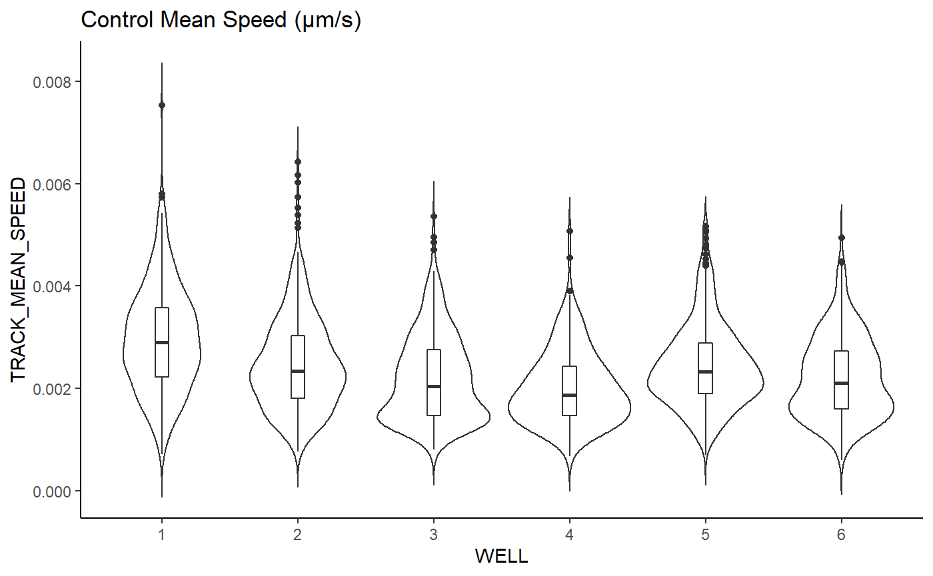
Live Tracking / Initial Violin Plots

Slide 15
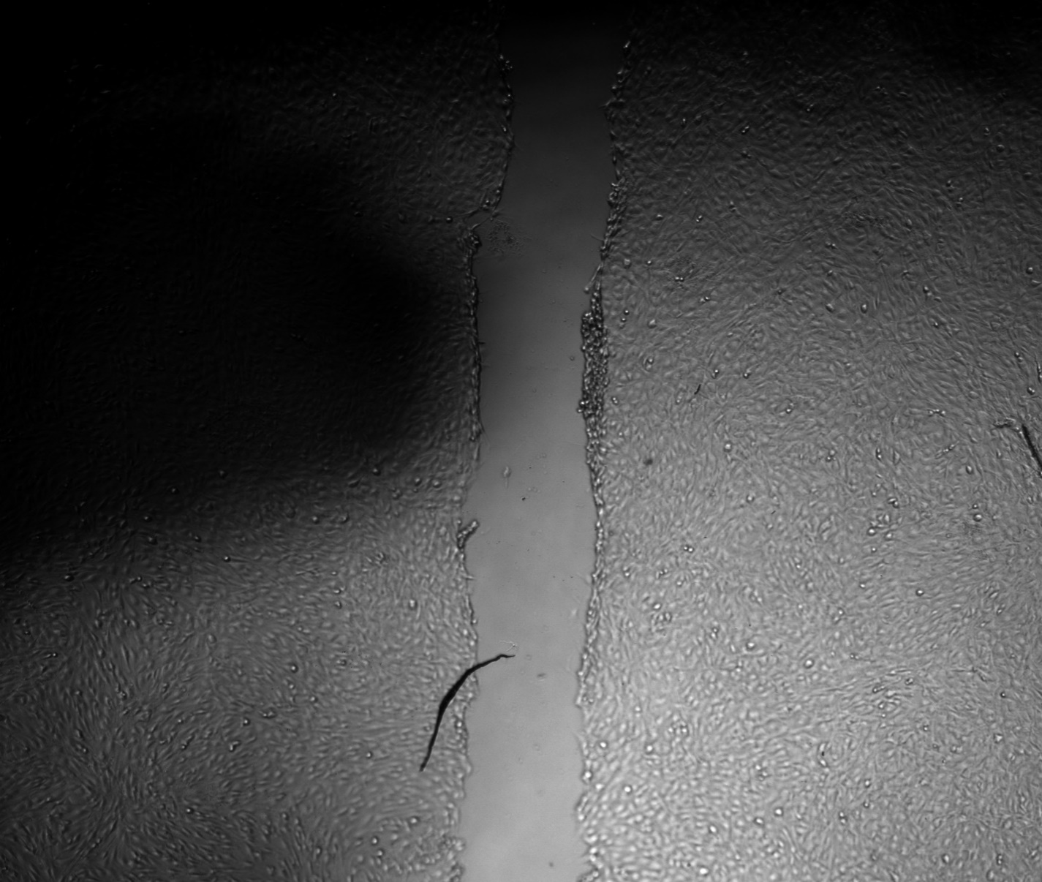
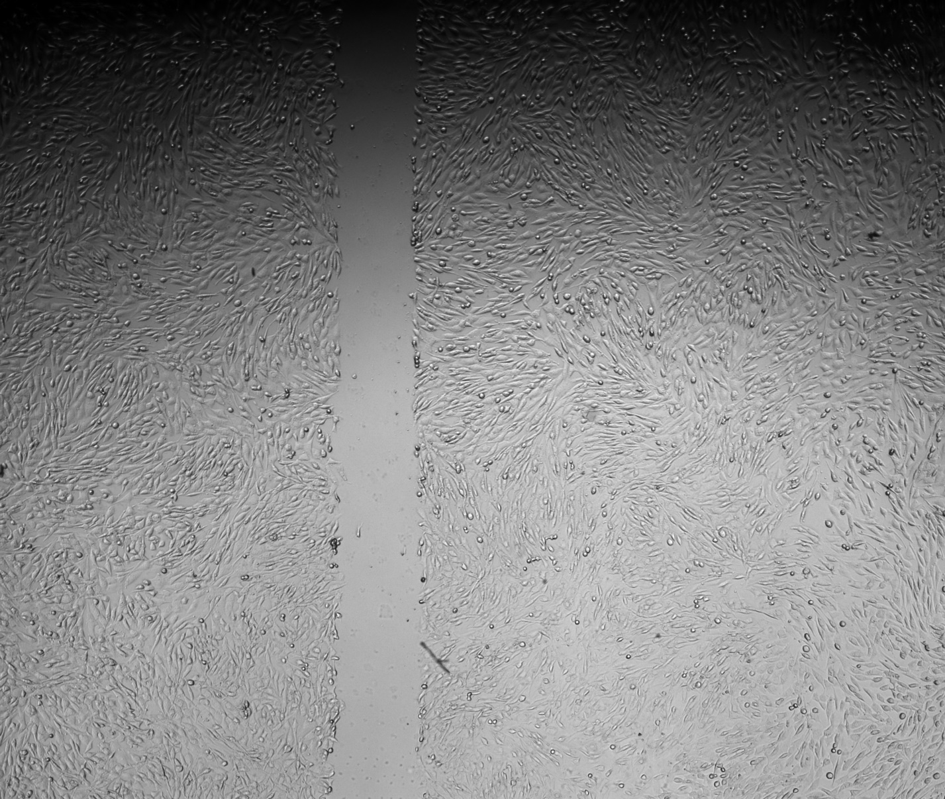
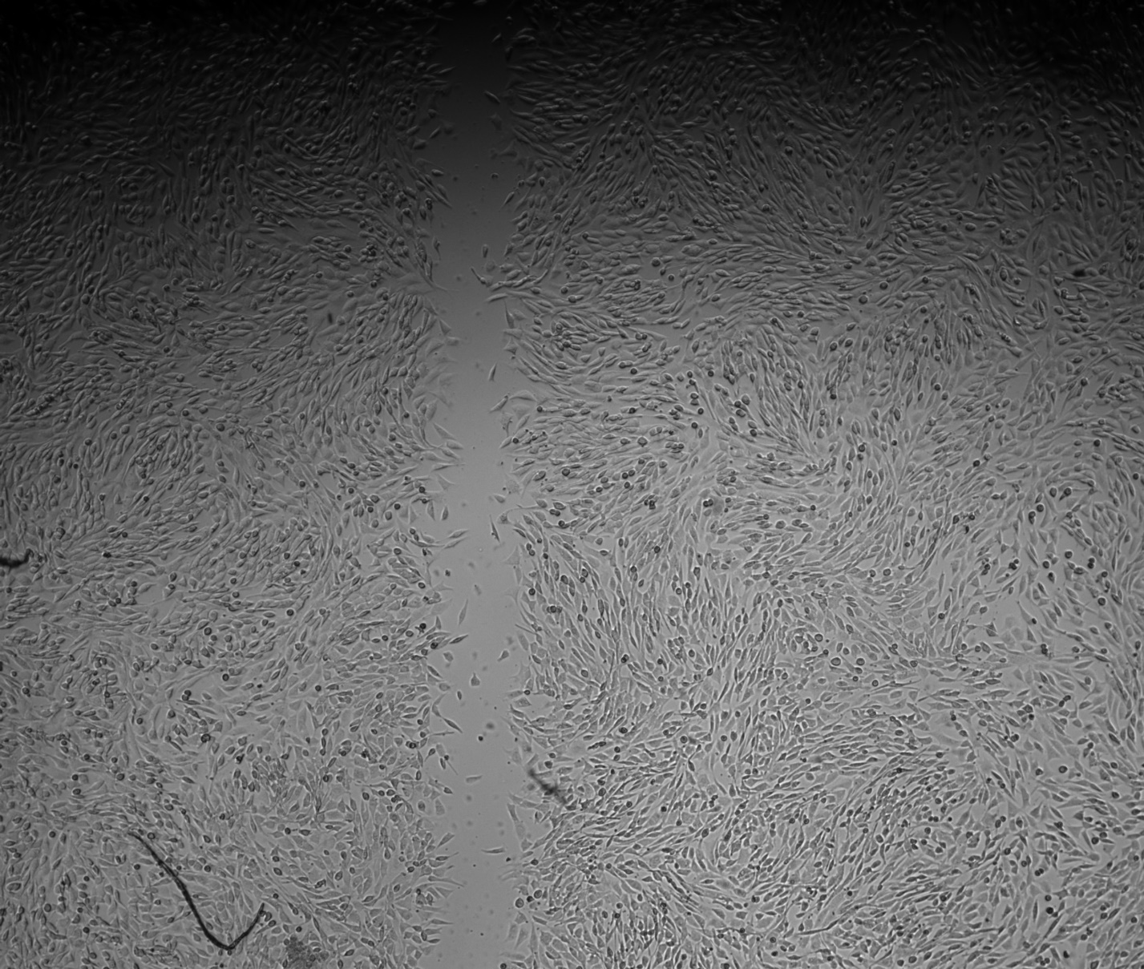
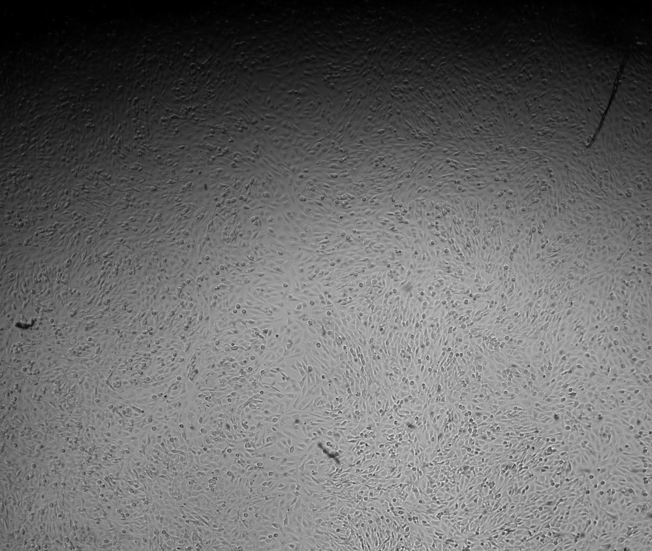
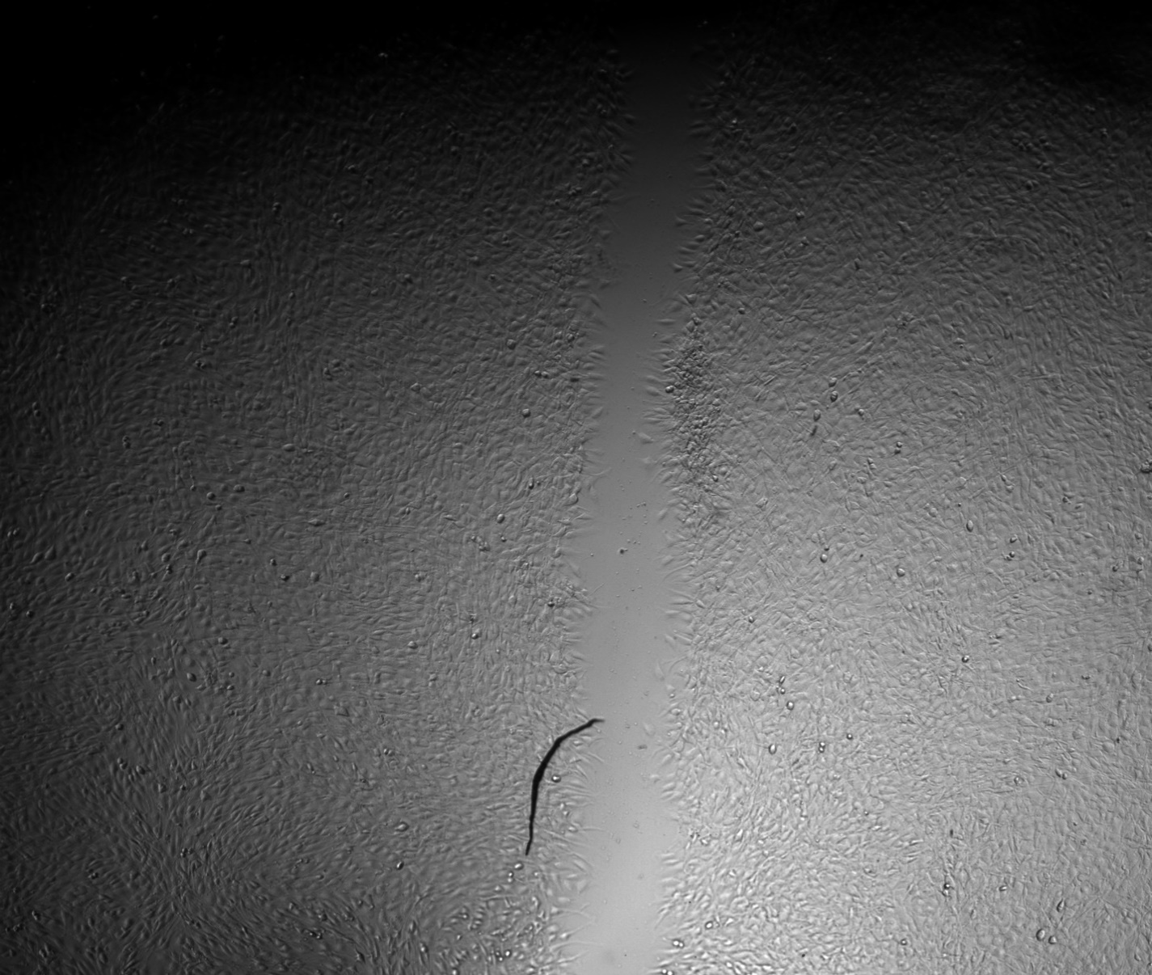
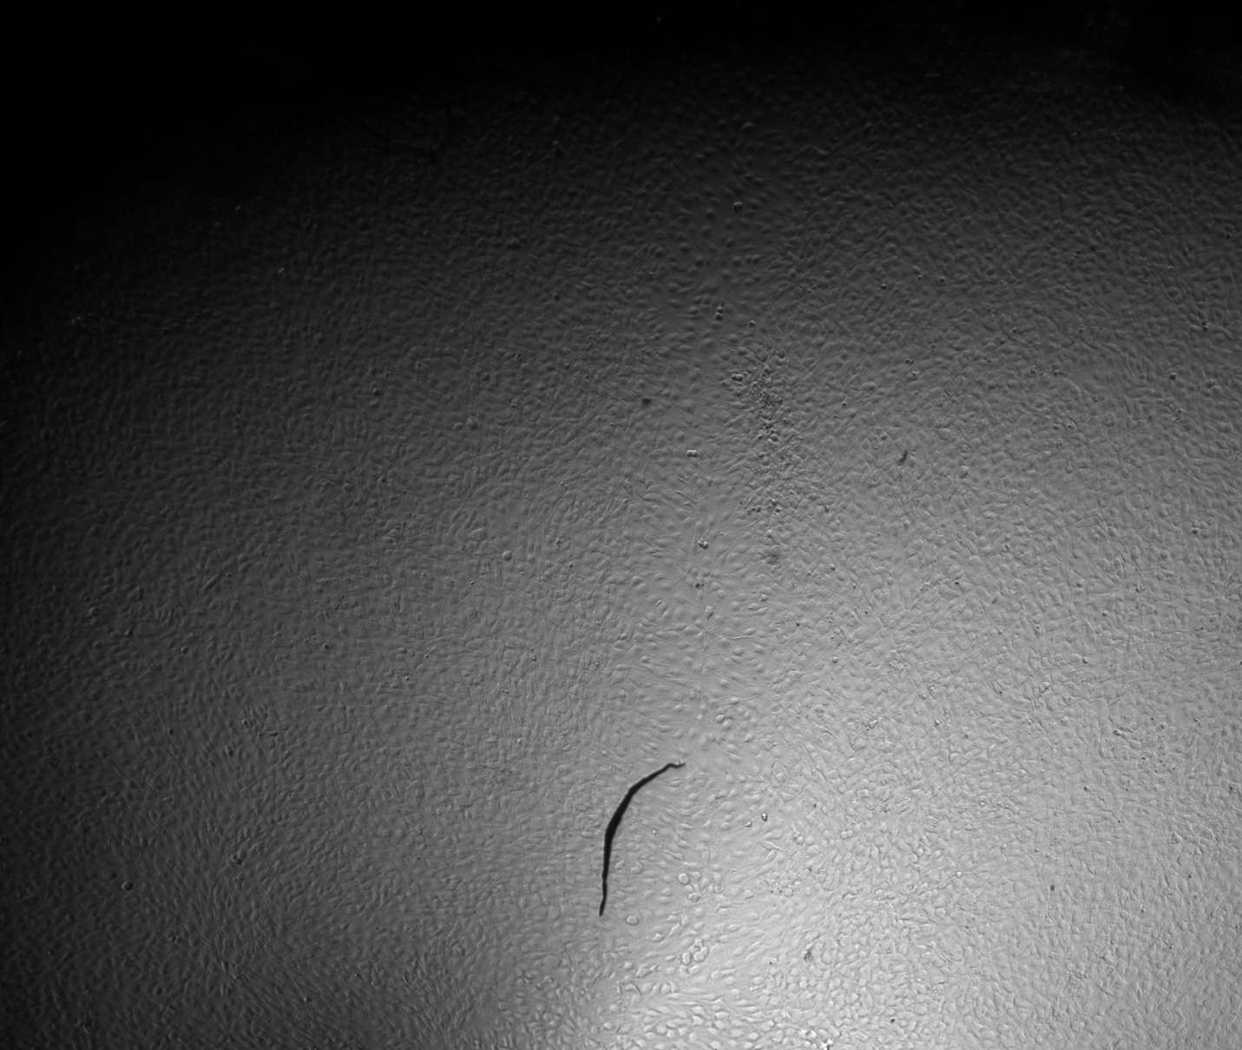
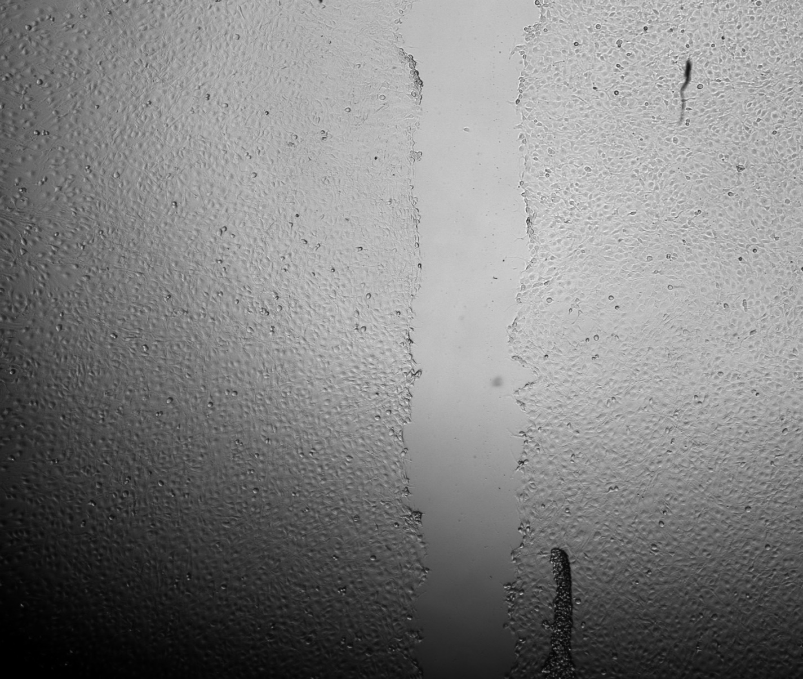
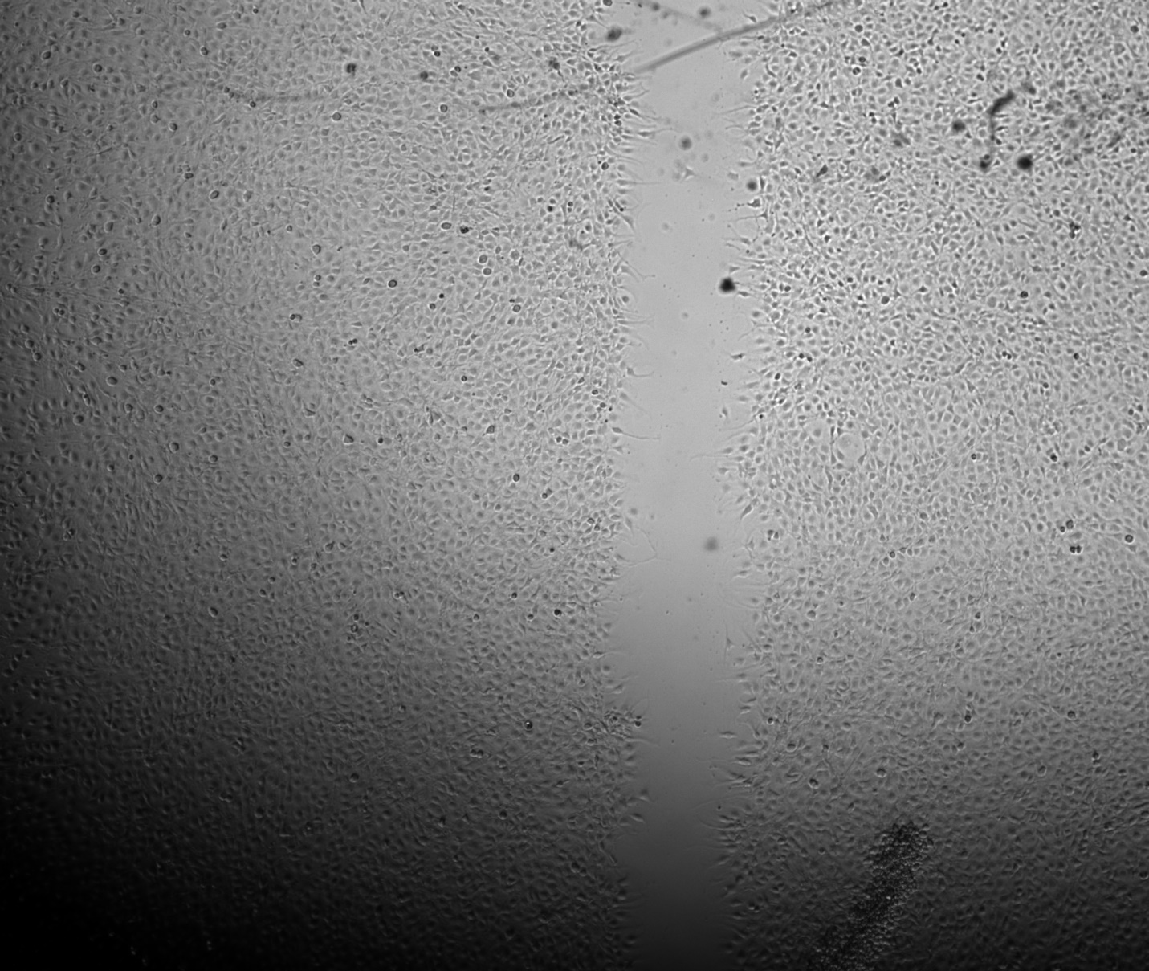
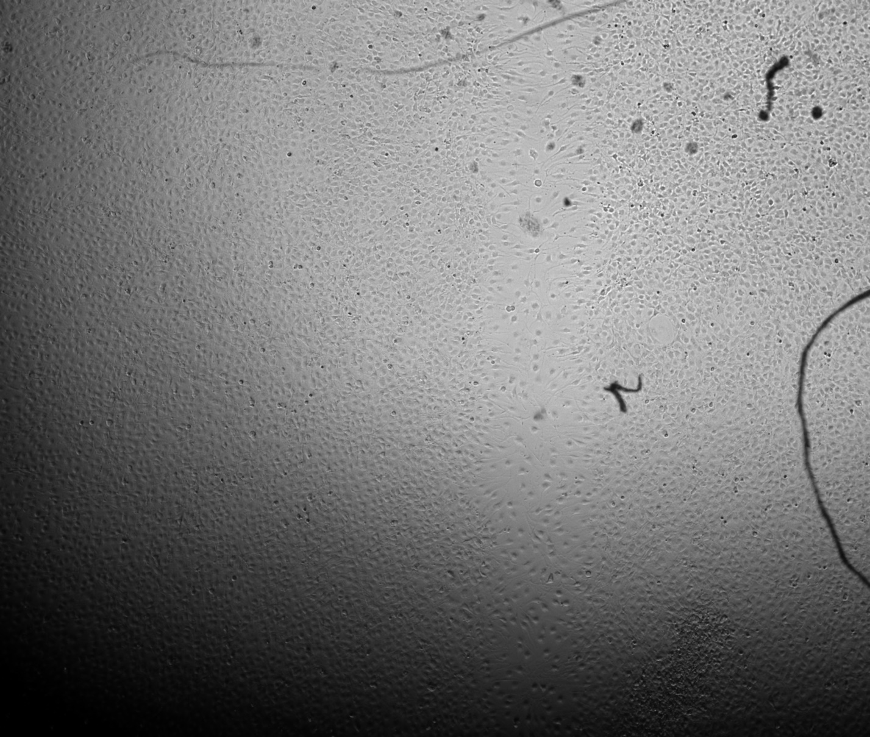
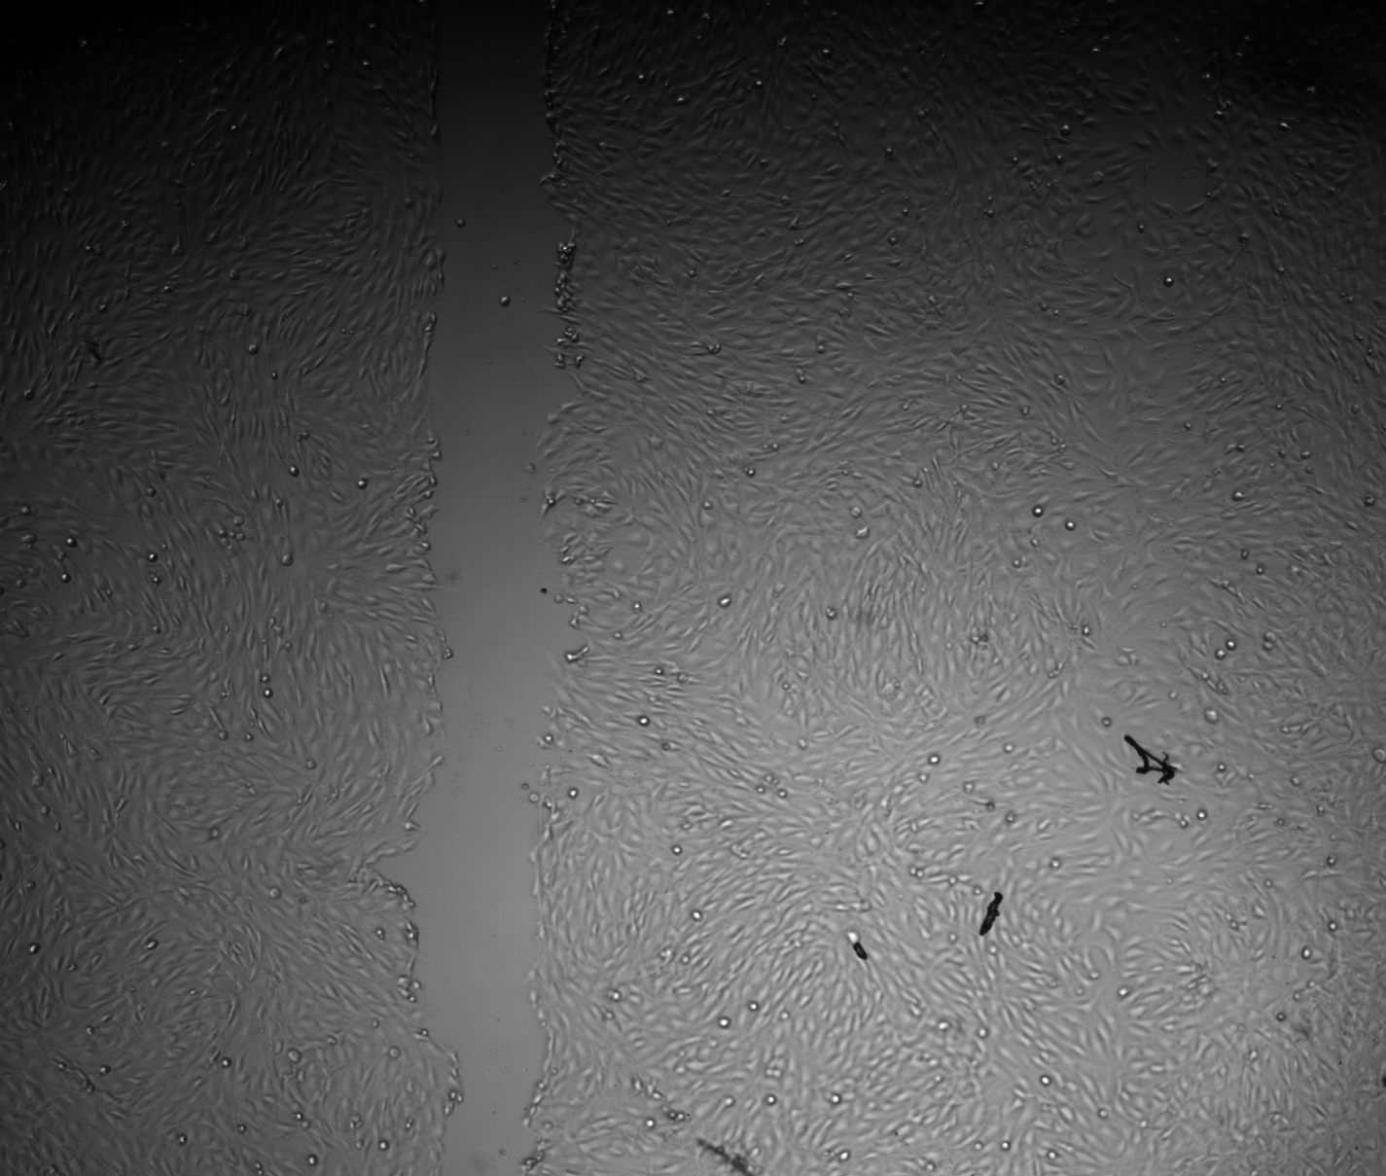
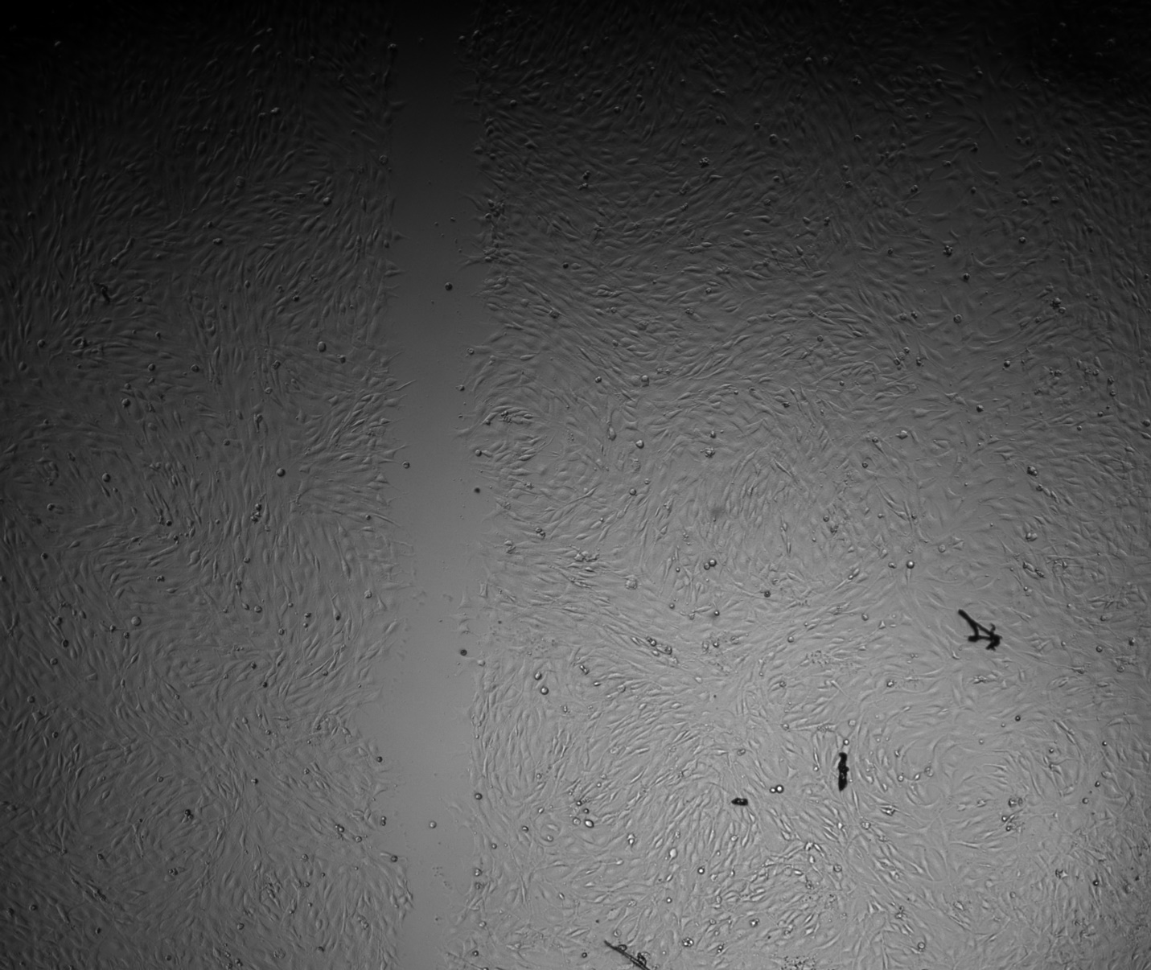
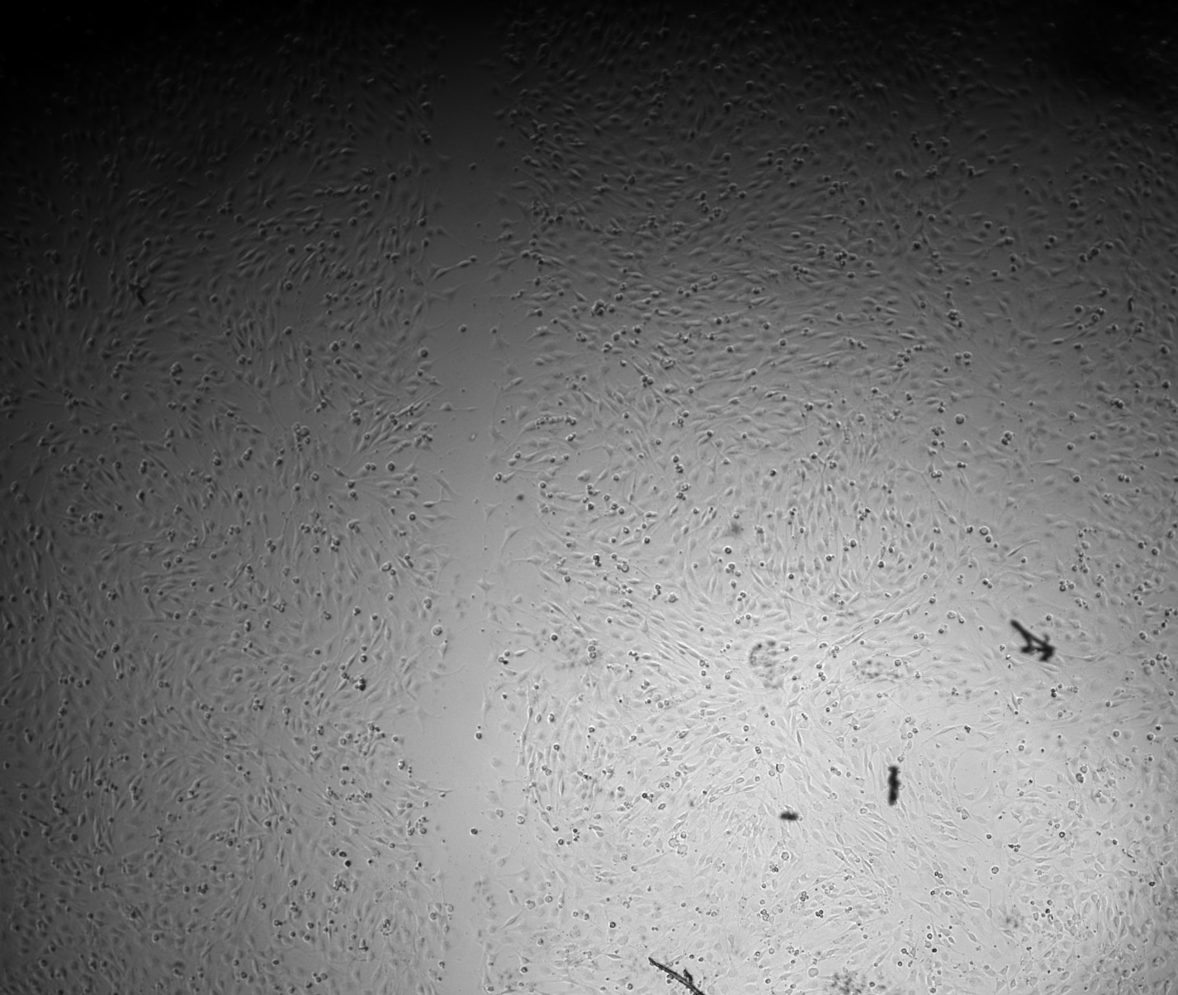
Control Group
20μM GSK126
200μm
200μm
200μm
0 hours after scratch
4 hours after scratch
21 hours after scratch
0 hours after scratch
4 hours after scratch
21 hours after scratch
20μM Y27632
100 ng/mL Trichostatin A
200μm
200μm
Notes:
Those images are then shown here starting with the control group on the top and the Y27 treatment group at the bottom. The left column shows immediately after the scratch application, the middle at four hours after the scratch, and the right at 21 hours after the scratch. Comparing these two groups we can see noticeably less migration with the Y27 treatment which was expected for validating the setup as Y27 is a blocker of actomyosin contraction. This group then shows the GSK treatment which appears to have increased the rate of migration compared to the control from a visual analysis which is really exciting. This is especially clear in the four-hour timepoints but even with the 21-hour timepoints you can faintly see an outline of the original scratch in some spots of the control where the same can’t be said for the GSK group. Lastly, here we see the TSA group which exhibited a large decrease in migration compared to the control with the amount of migration being even lower than that seen with blocking actomyosin contraction. These images show just one well per treatment group, but the same trends were seen in the other wells too.

Slide 16
